Slide 1


The FLS Partnership
Look how far we’ve come
May 2025

Slide 2
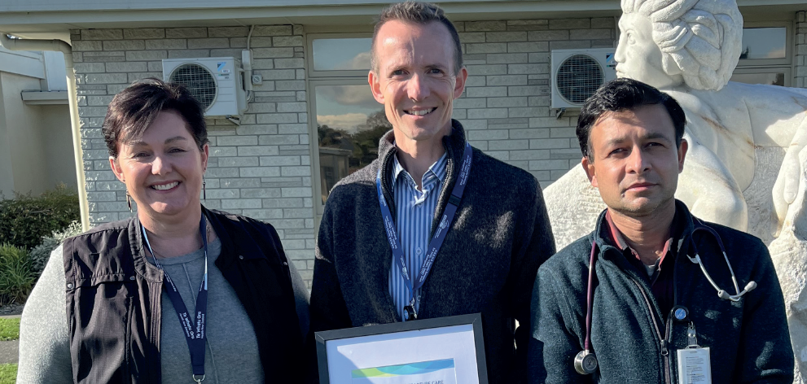


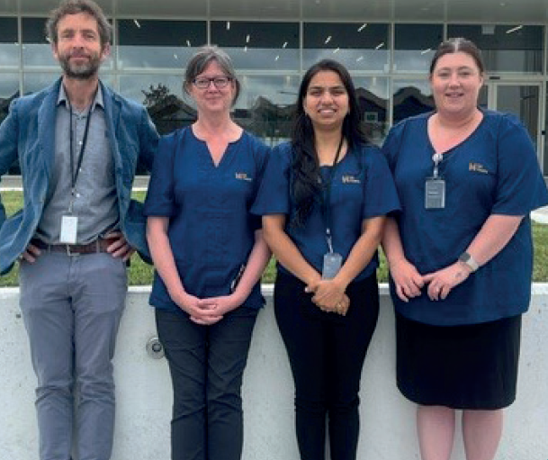

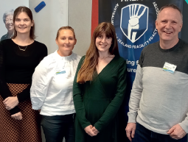


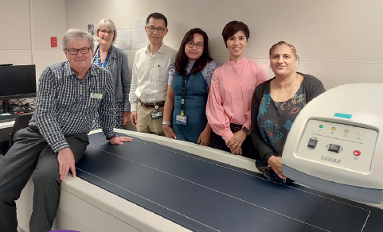

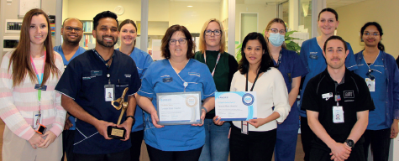


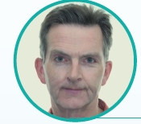

It takes a team
Photo’s sourced from the 2025 ANZFFR Annual Report

Slide 3

The Growing Health Burden

Slide 4
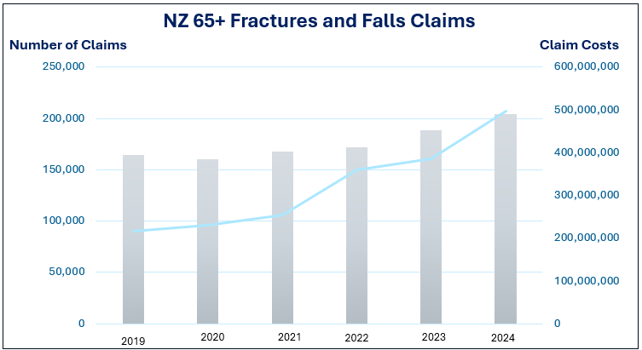
NZ’s ageing population
Between 20-30% of people aged 65 years and above fall each year and 10-20% of these events result in a serious injury such as a hip fracture, hospitalisation, or death.
Population forecasts indicate that in the absence of interventions, ACC should expect the present cost of older adult falls to increase by as much as 100% by 2035.

Slide 5

Fragility fractures - demand on NZ’s healthcare
Fragility fractures place a significant demand on NZ’s healthcare system, accounting for over 191,000 hospital bed days annually.
To put these numbers into perspective, if all fragility fracture patients in NZ were treated at a single hospital they would require 525 beds, the equivalent of NZ’s sixth largest hospital.
Similarly, a “Fragility Fractures and Falls Hospital” accommodating all such patients would need 843 beds, ranking as the third largest hospital in the nation.
In the absence of interventions, older adult fall and fracture consumption of health system resources has the potential to constrain the capacity of New Zealand’s health system so significantly, that treatment and care for all other citizens presenting with illnesses and injuries could be negatively impacted.
Evidence shows that up to 30-40% of fragility fractures are preventable

Slide 6
FLS in New Zealand Bed Day Savings FY2024-25 to FY2028-29

Slide 7


Slide 8
Measures Of Success | Target | Actual
IOF Accreditation | Gold | 13 | 10
 | Silver | 7 | 7
 | Bronze |  | 2
 | Nil |  | 1
NZ Coverage of FLS (covering 19 of 20 districts) | 90% | 98%
Identification | 90% | 72%
Adherence | >50% | 52%
Refracture Tracker | No target | 94:6

Slide 9
“Are We There Yet?”
A Quality Improvement Reflection

Slide 10

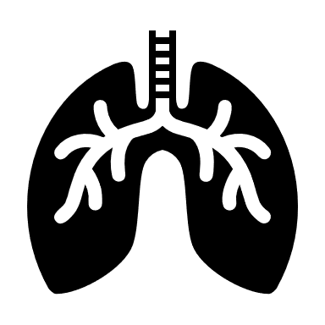










What we need to do -
Prioritise osteoporosis prevention
Cancer
Respiratory diseases
Diabetes
Cardiovascular disease
Mental health
Osteoporosis
Modifiable risk factors
Reduce harm from alcohol
Reduce smoking
Improve nutrition
Increase physical activity and reduce sedentary lifestyles
Improve resilience and mental wellbeing
HNZ’s 5 x 5 Prevention Framework

Slide 11

Systems Approach
Notes:
falls reduction requires a systems approach" means that effectively reducing falls—especially in complex environments like hospitals, long-term care facilities, or community health—
cannot be accomplished through isolated efforts or quick fixes.
Instead, it requires coordinated changes across multiple layers of an organization or system.
Long-term participation in Falls Prevention Programmes is needed to achieve ongoing reduction of falls risk, similar to long-term adherence with osteoporosis-specific treatment being required to maintain/improve bone health. However, there is currently no standardised mechanism to track participation beyond the 16-week follow-up conducted by FLS.

Slide 12
Have a great Facture Fest 2025

