Slide 1

Making a Difference
Highlights from the second ANZFFR Annual Report
Frazer Anderson
ANZFFR National Clinical Lead
Whangarei Hospital and Northland District
Te Whatu Ora HNZ Te Tai Tokerau
Fracture Fest 2025 Wellington

Slide 2
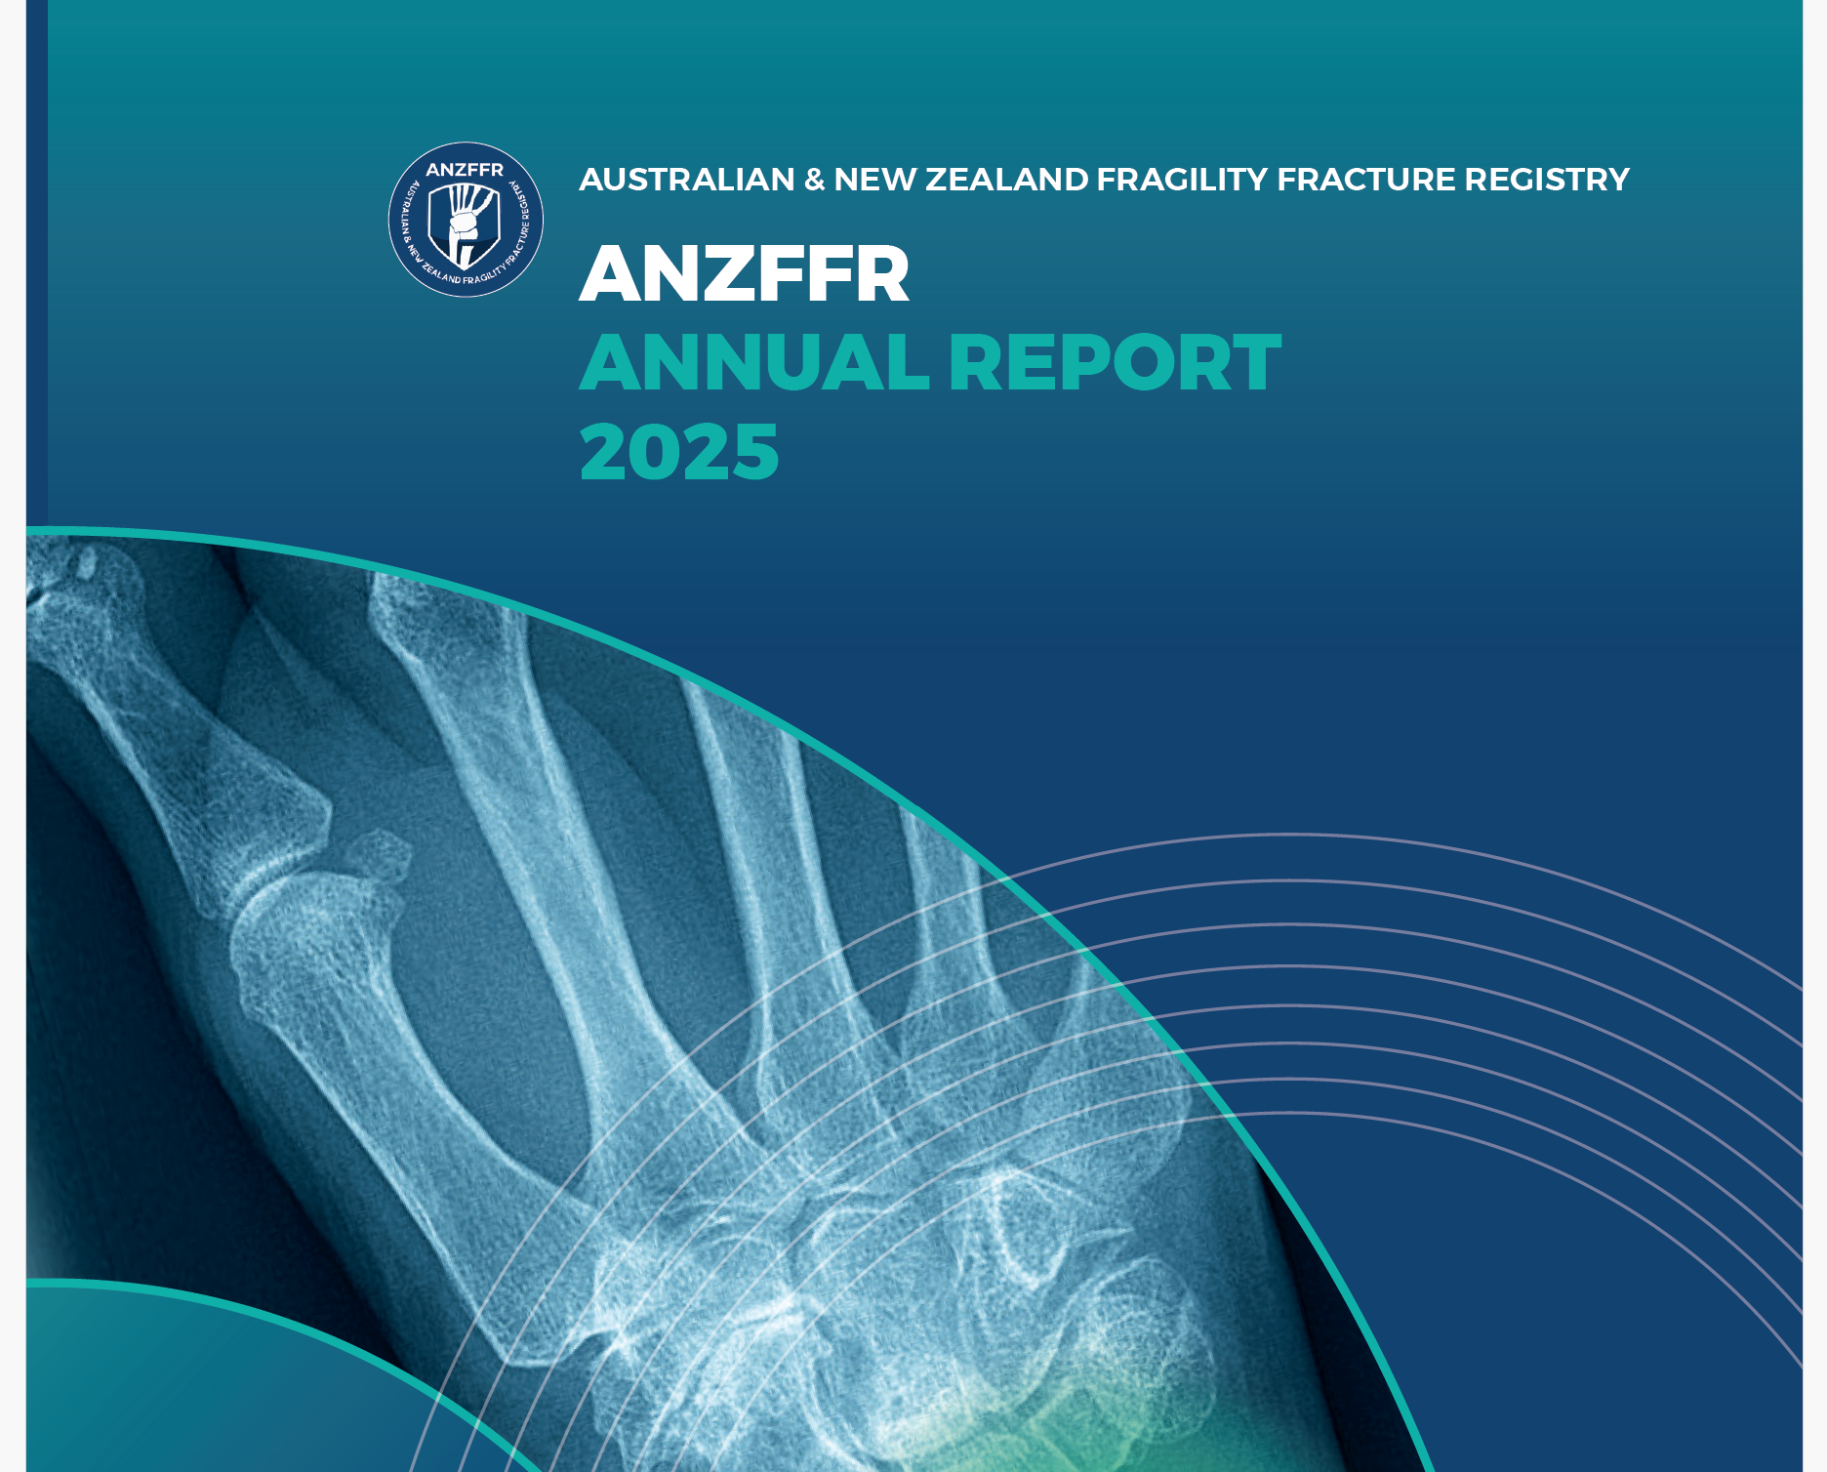
The 2025 Annual Report
Planting a flag for our achievements:
  Much increased recruitment
  High treatment rate at 1 year
  National coverage
  Good care is the new normal
Maintaining the momentum
Maintaining the focus on our patients and teams

Slide 3

Completeness of coverage
98.9% of NZ population has access to an FLS
Soon (we hope) to be 100%
Nobody else – not even the Swedes – has 100%
This normalises the FLS “package” as a standard of care
It will soon seem odd and unsafe not to have FLS access for everyone

Slide 4
Recruitment
Registries stand or fall on completeness
Participation in a Registry should be as inclusive as possible
In Year 1 we recruited 55% of predicted fragility fractures in NZ
In Year 2 we recruited 72% of predicted – a 30% increase
Over 15,000 people
Not explained simply by more centres so must be better capture
But are we making a difference?

Slide 5
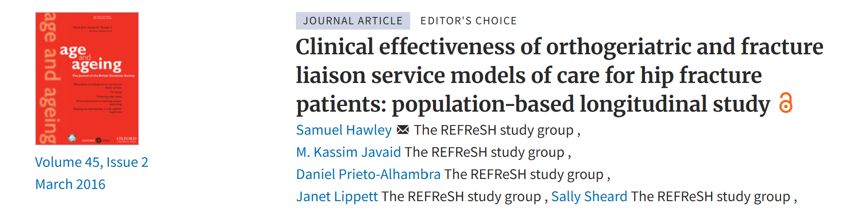
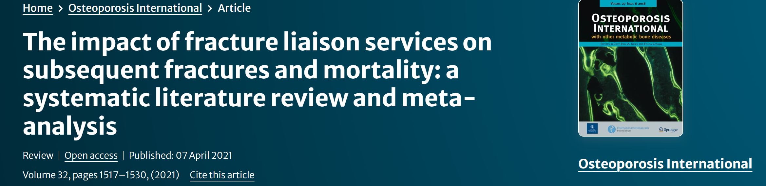
Why should having an FLS matter?
Before-and-after FLS
Whole-system analysis
Meta-analysis (12 studies)
30% reduction in fractures
12-20% reduction in mortality

Slide 6
NHFD reduced mortality
Neuburger et al, Med Care 2015
Before-After NHFD comparison 2003-07 vs. 2007-11
30-day Mortality fell from 11.5 - 10.9% in first period vs 10.9 - 8.5% in second
Wise in BMJ 2015 estimated 1000 lives saved in 5 years

Slide 7
52-week data on treatment persistence?
After one year, 75% of people recommended treatment were taking an effective fracture prevention drug

Slide 8
52-week data on treatment persistence?
After one year, of people who were recommended treatment were taking an effective fracture prevention drug
75%

Slide 9
52-week data on treatment persistence?
In most population studies where there is no FLS, one-year persistence is around 20%
Even where there are FLSs, typical rates are around 40%
This data is before LTCPs are introduced

Slide 10
But is it working?
Results from the Refracture Tracker suggest that it is:
  12-month RT rate = 3.3%
  Median patient has exactly 6 months of follow-up
  “True rate” is therefore about 6.6%
  Internationally comparable populations typically show 10-12% year 1 re-fracture rate
    (Hip # typically around 20%)
  So our Fracture Risk Reduction is about 30-35%
  Bear in mind this is for the whole cohort not just the treated

Slide 11
Mortality
“Intention to treat” cohort:
Whole cohort including “not for treatment”:
75% were in the ITT group, 25% were not for treatment

Slide 12
Mortality – understanding the results
The 6 percentage point difference shows that the NFT group had a net mortality rate 24% greater than the ITT group
Adding in the whole-group figure of 16% = 40%
We didn’t extract the “DXA says no” group separately (silly me…)
A rough calculation on my Northland recruits is 6% “DXA no”
Pasting that back into the NFT figure at standard mortality…
The NFT Frail group had a mortality of nearly 50%

Slide 13
Mortality – tentative conclusions
Our assessment process correctly identifies a lot of the people who are too frail for bone health intervention to be appropriate
Overall mortality is at the “good end” of global results but not yet significantly different
There’s a lot more work to do on this… but for now that’s my job not yours.
I promise that next year’s report will present this better!

Slide 14
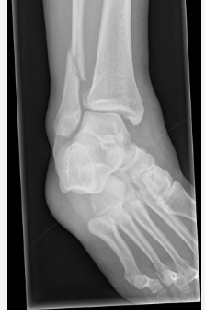
NZ FLS – things we need to know
Which fractures outside the Big 5 are worth intervention and treatment?
Is denosumab going to change anything?
How much would broader access to DXA change our treatment recommendations?
Is P1NP any use?
If fracture rates start falling, is this a result of FLS and the Registry?
If so, can we prove it?

Slide 15


NZ FLS – Risks
A lot of you are struggling with pressure on your funding and team FTE
We’ve got to promote this better or people will not appreciate what we do
Short-term contracts = higher turnover
Limited cover for absence
“Slave to the numbers”
Competing with each other

Slide 16
Takeaways
  Every single one of you has by your actions almost certainly prevented a sizeable number of people suffering a fragility fracture
  It is highly likely that you have prevented a small but non-trivial number of premature deaths
  Thank you!

