Slide 1
Fracture Fest:
Quality Improvement - What is it and what does it mean?
15 May 2025
Harminder Gill, CNS Quality Improvement ONZ
Ian Hutchby, Improvement and Innovation Training Manager, Te Whatu Ora Improve

Slide 2
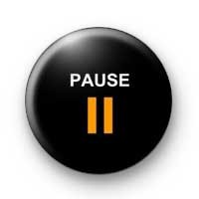

What is quality
Define what quality means to you?
What words/concepts do you associate with quality?
What defines (good or poor) quality in healthcare?

Slide 3
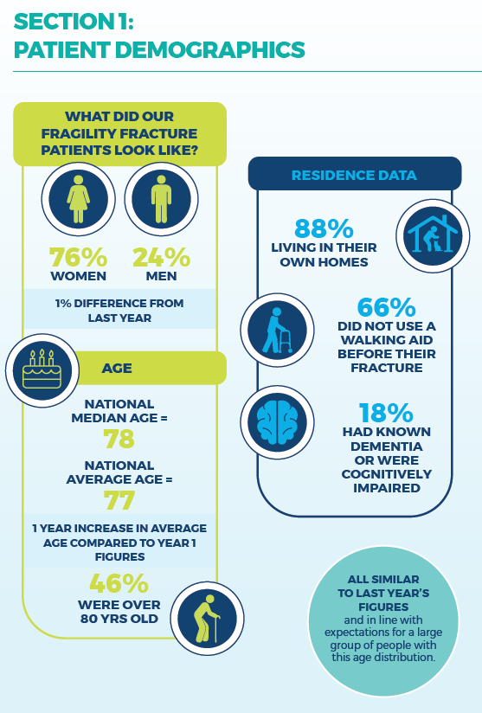
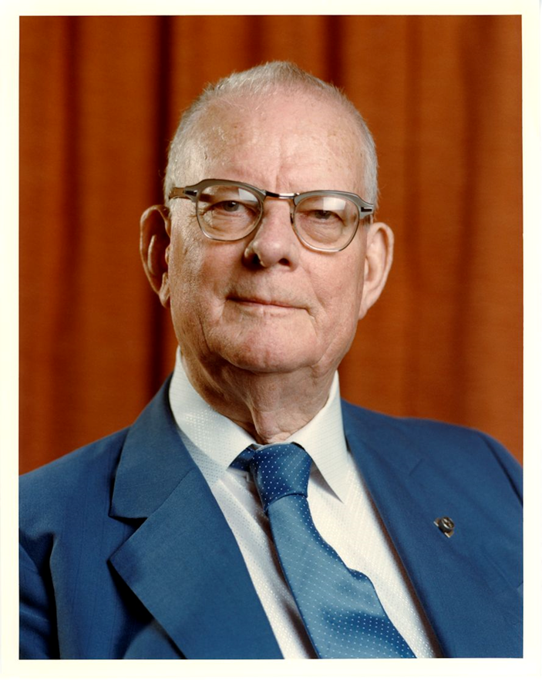
Defining Quality
“Quality is meeting and exceeding the customer’s needs and expectations and then continuing to improve”
W Edwards Deming

Slide 4
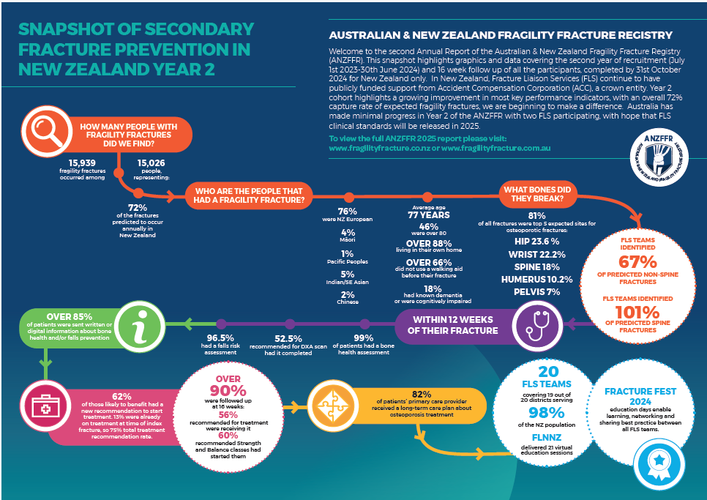
Institute of Medicine
“the degree to which health care services for individuals and populations increase the likelihood of desired health outcomes and are consistent with current professional knowledge."

Slide 5
What is improvement?

Slide 6
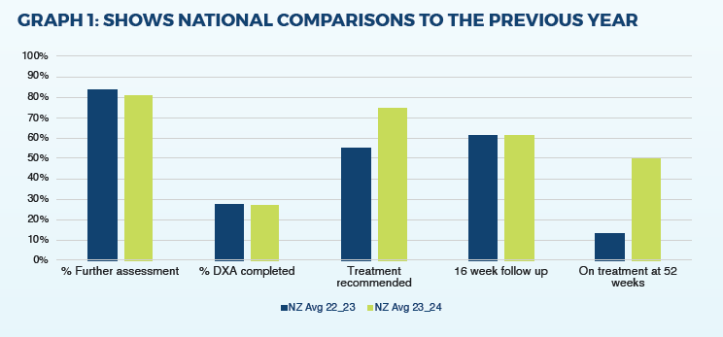
Improvement
Dictionary definition: an occasion when something gets better or when you make it better.
Ian’s definition: find something that annoys you, if once you have tested some ideas it no longer annoys you it is an improvement.

Slide 7
Improvement
“All improvement requires change, but not all changes are an improvement”
Attributed to Don Berwick or Paul Bataldan
“If you do what you’ve always done, you’ll get what you’ve always gotten”
- Tony Robbins

Slide 8
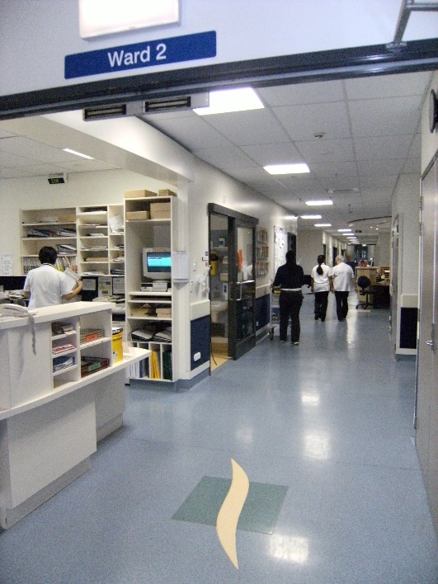
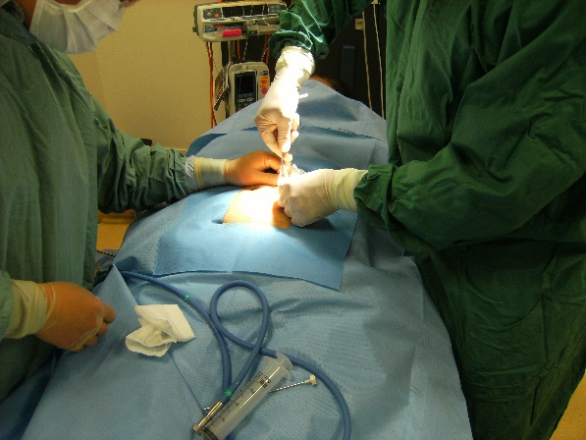
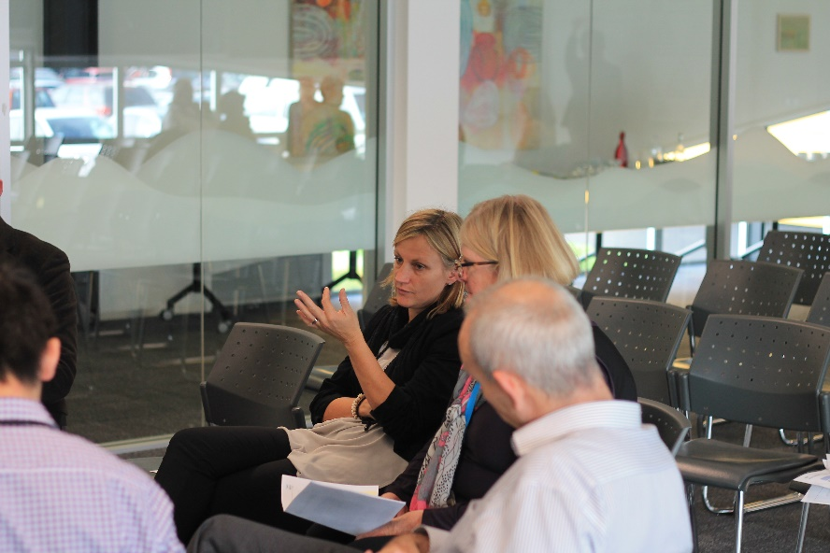
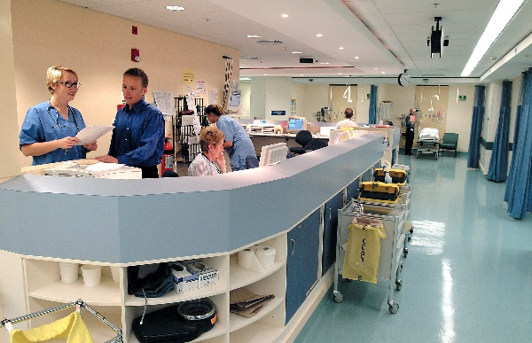
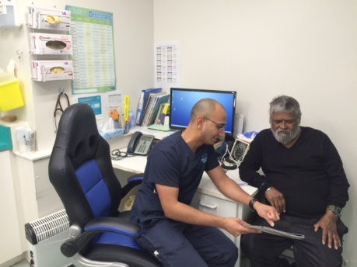
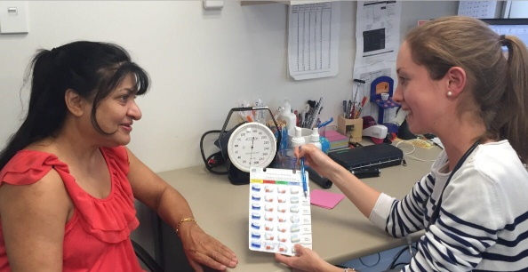
Where does the improvement occur?

Slide 9


The System of Profound Knowledge – AKA improvement science

Slide 10
2 Types of knowledge
Subject Matter Knowledge
Profound Knowledge
(Improvement Science)

Slide 11
2 Types of knowledge
Subject Matter Knowledge
Subject matter expertise without Profound knowledge
Improvement is ad hoc at best

Slide 12
2 Types of knowledge
Profound knowledge without subject matter expertise
Is the right thing being improved?
Is it practical?
Profound Knowledge
(Improvement Science)

Slide 13
2 Types of knowledge
Subject Matter Knowledge
Profound Knowledge
(Improvement Science)

Slide 14
2 Types of knowledge
Subject Matter Knowledge
Improvement
Profound Knowledge
(Improvement Science)

Slide 15
2 Types of knowledge
Profound Knowledge
(Improvement Science)

Slide 16
2 Types of knowledge
Appreciation for a system
Theory of knowledge
Knowledge of Variation
Psychology of change

Slide 17
Systems Thinking
Appreciation for a system
Theory of knowledge
Knowledge of Variation
Psychology of change

Slide 18
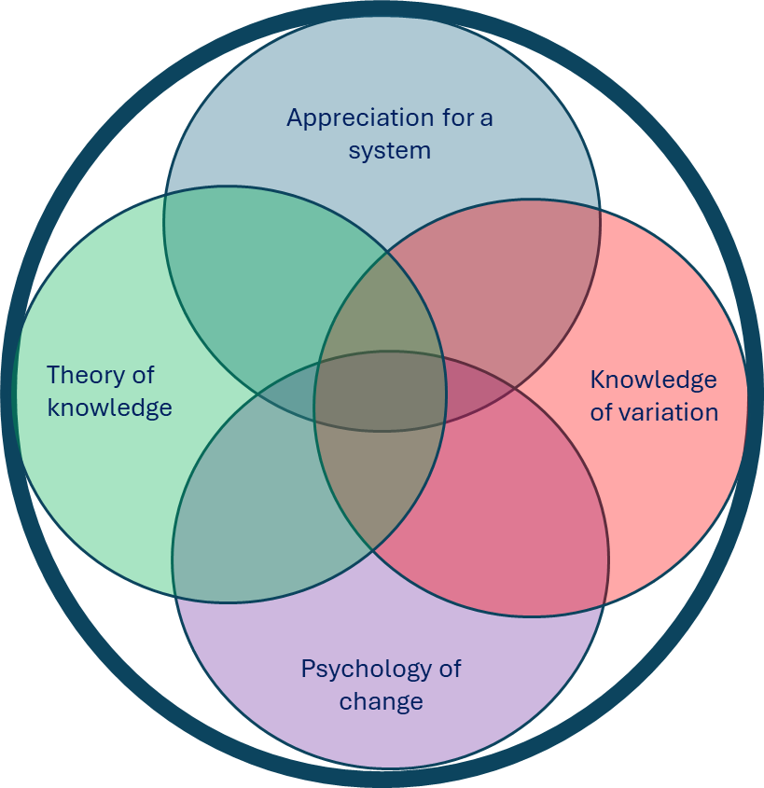
Systems thinking – Cynefin Framework
Complicated
Complex
Complicated
Complex
Disorder
Disorder
Chaotic
Chaotic
Simple
Simple

Slide 19
Knowledge of Variation
Appreciation for a system
Theory of knowledge
Knowledge of Variation
Psychology of change

Slide 20
Variation happens
Every process/system however tightly controlled will exhibit some variation
The system is perfectly designed to get the results it does – ie most variation is due to the system
You can exploit variation to learn more about the system and what/how to improve

Slide 21
Data over time
When looking at 2 data points, 1 will always be larger than the other
Providing the data over time helps provide a context
Variation will be present – look at the overall pattern rather than individual differences
Use the data to help frame learning questions

Slide 22
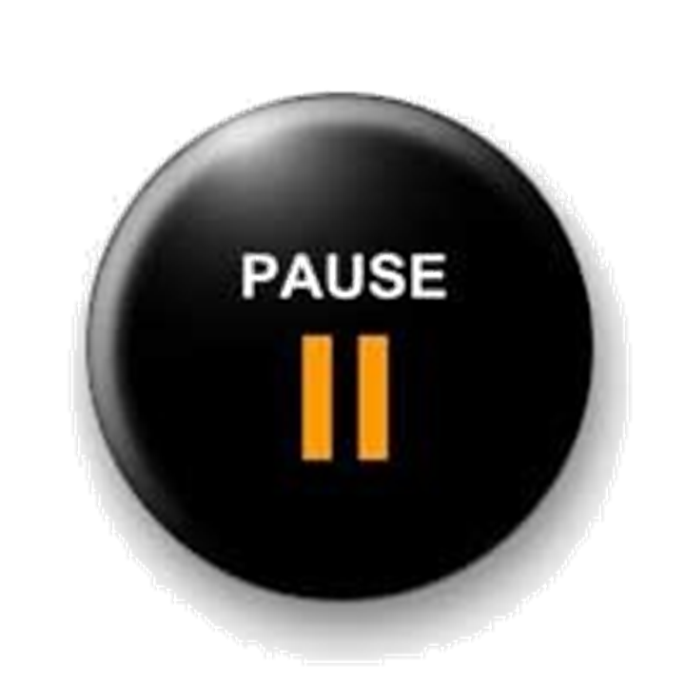
Hand hygiene example
Hand hygiene gold audit result board reporting (verbatim)
“Kidz First Medical - Compliance rate 86.8%
a decrease from 91.5%”
Performing a test of significance
  p value is 0.0406

Slide 23
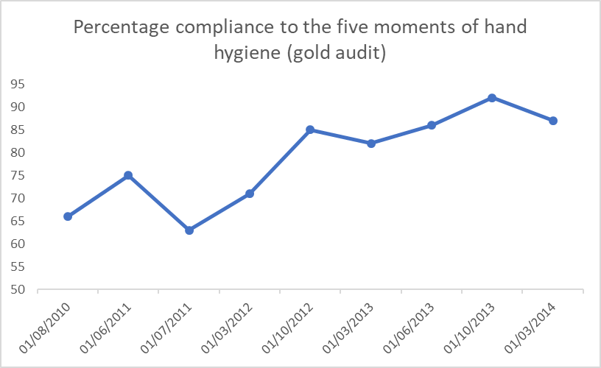


“Kidz First Medical - Compliance rate 86.8%
a decrease from 91.5%”
This Photo by Unknown Author is licensed under CC BY-NC
This Photo by Unknown Author is licensed under CC BY-NC
This Photo by Unknown Author is licensed under CC BY-NC

Slide 24
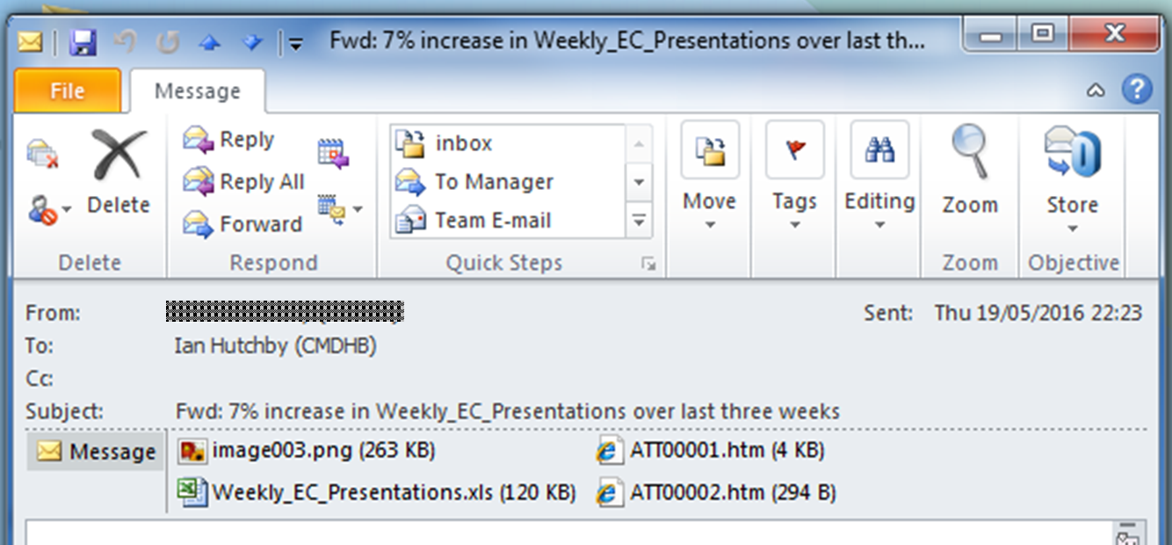
Another example

Slide 25
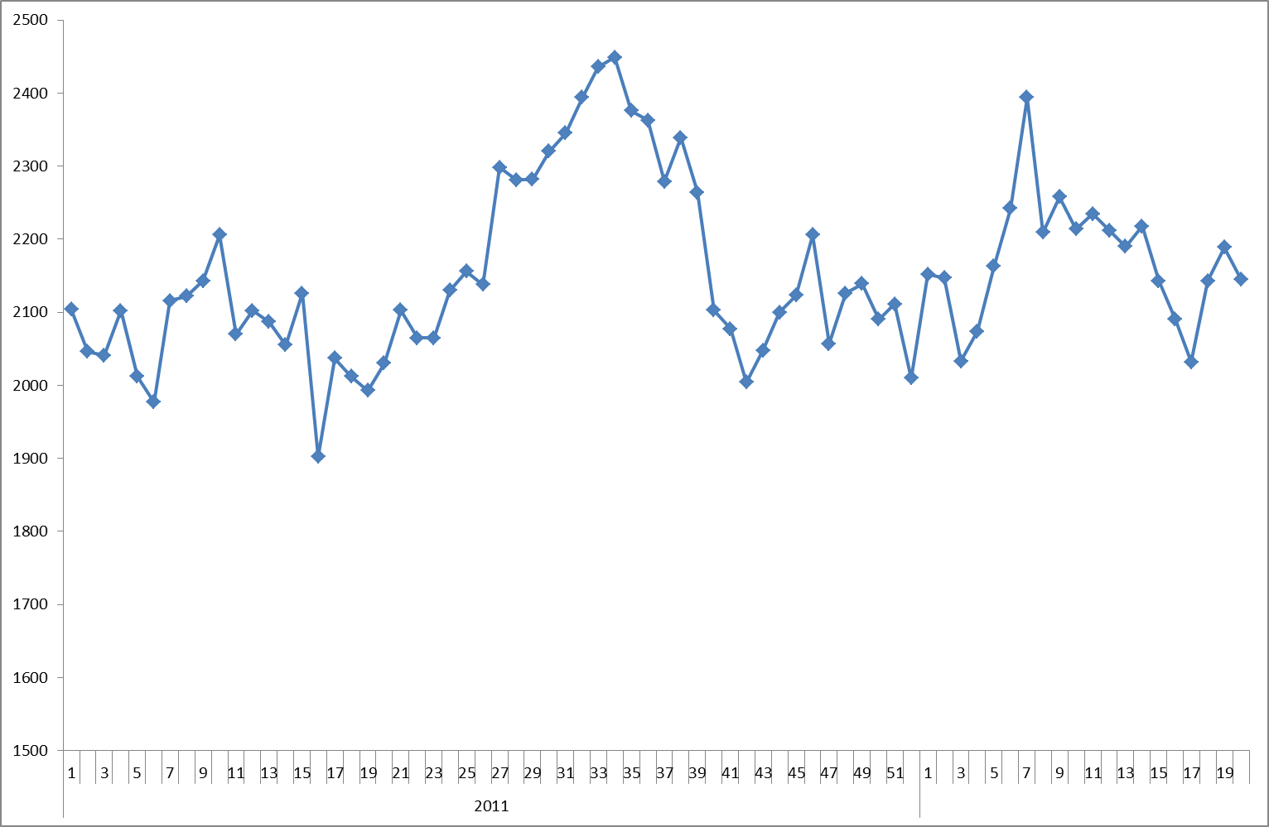
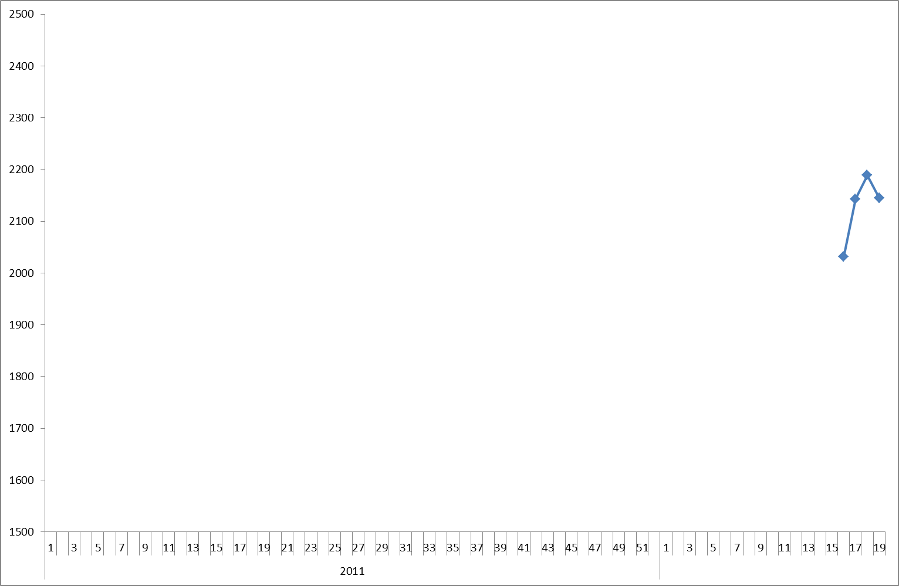

Slide 26
Data over time
When looking at 2 data points, 1 will always be larger than the other
Providing the data over time helps provide a context
Variation will be present – look at the overall pattern rather than individual differences
Use the data to help frame learning questions

Slide 27
Psychology of change
Appreciation for a system
Theory of knowledge
Knowledge of Variation
Psychology of change

Slide 28

Everyone is different
Some people change when
they feel the heat
others when they see the light

Slide 29
Change is fundamental to improvement
“All improvement requires change, but not all changes will result in an improvement”

Slide 30
Begin change management early
Take the time to:
Identify your stakeholders
Create a change management strategy and plan
Look at the big picture
Bring stakeholders along for the journey

Slide 31
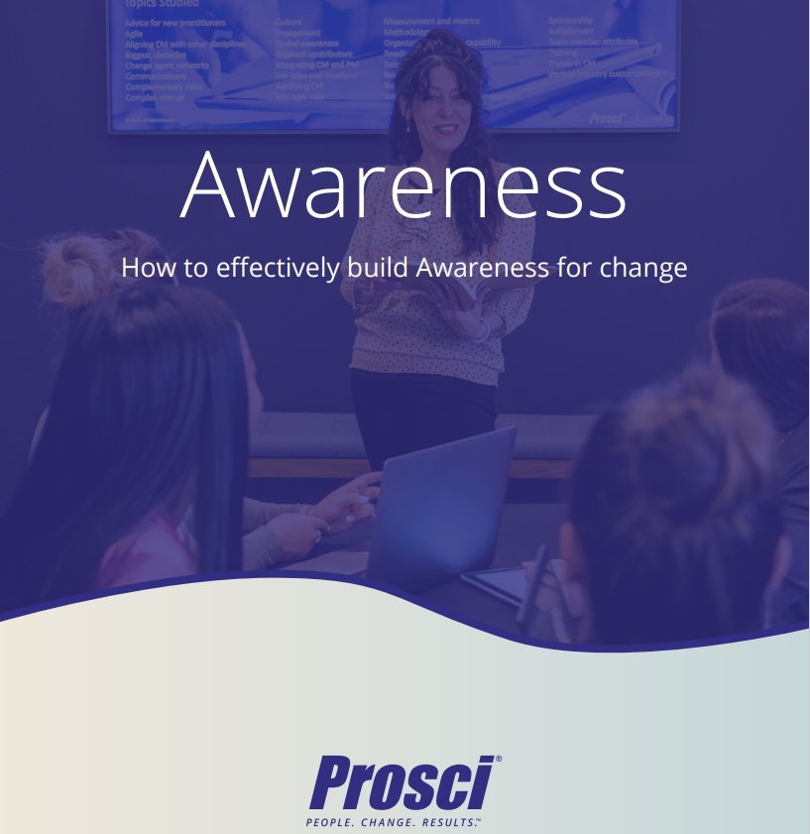


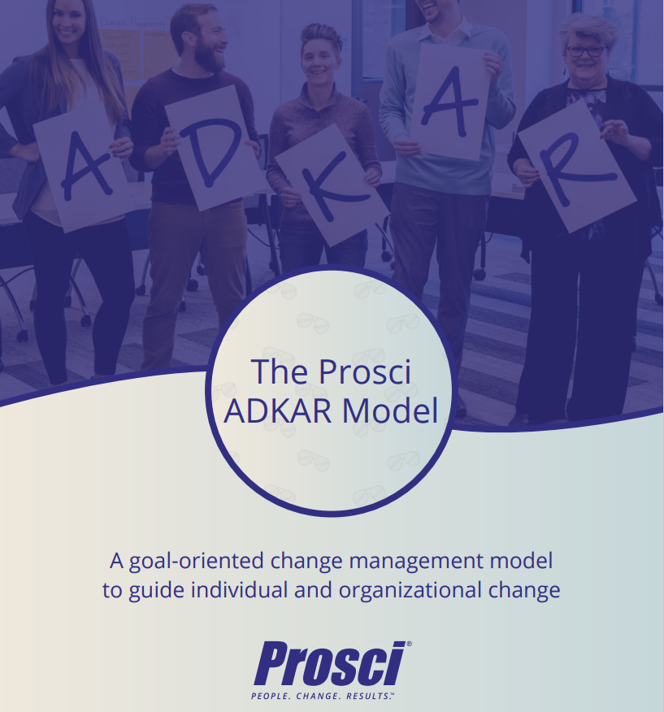


ADKAR (ProSci) – a framework for managing change

Slide 32
ADKAR (Prosci) – 5 step process
Awareness I understand why…
Desire I have decided to…
Knowledge I know how to…
Ability I am able to…
Reinforcement I will continue to…

Slide 33
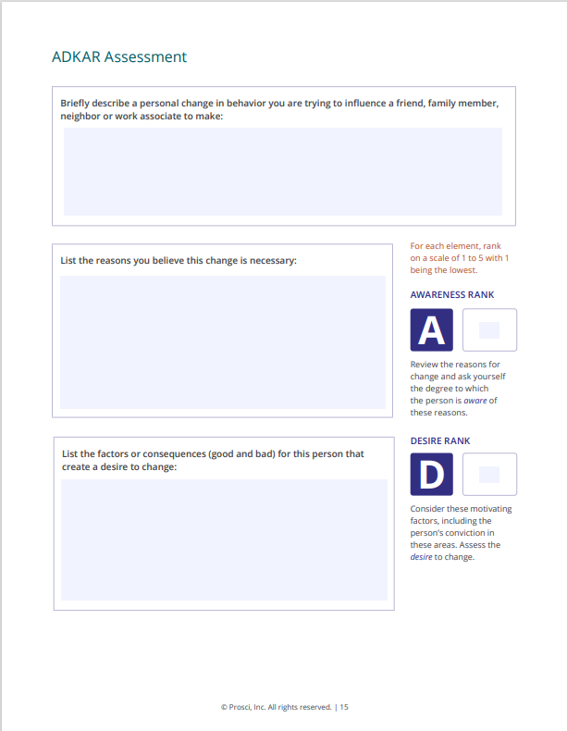
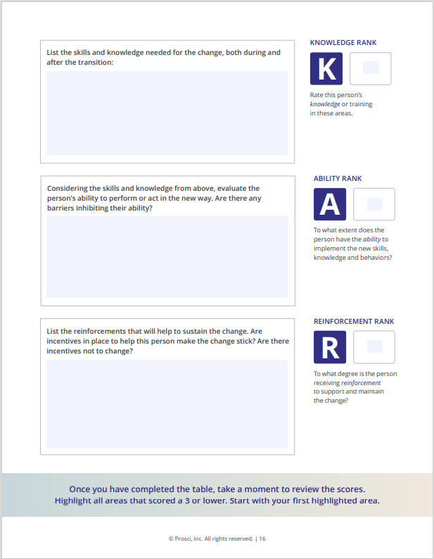

Slide 34
Theory of Knowledge
Appreciation for a system
Theory of knowledge
Knowledge of Variation
Psychology of change

Slide 35
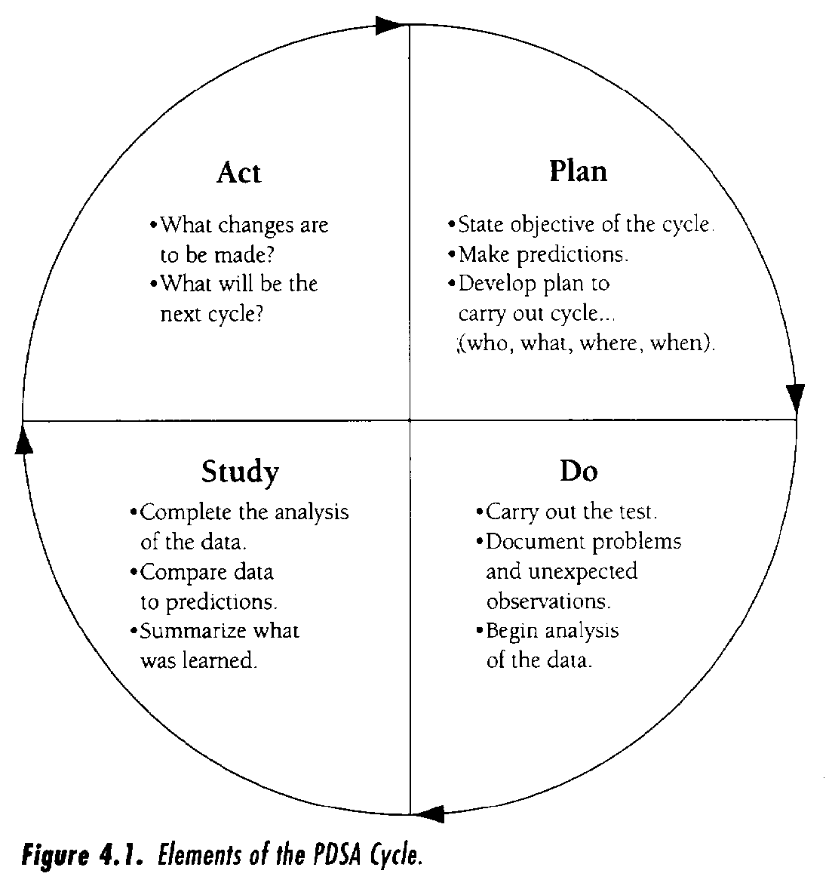
PDSA learning cycle
Langley et. Al

Slide 36
Positive deviance
“Positive deviance is the observation that in most settings a few at risk individuals follow uncommon beneficial practices and consequently experience better outcomes than their neighbours who share similar risks”
The power of positive deviance Marsh et Al, BMJ 2004;329:1177-9
Notes:
Amy- PD

Slide 37
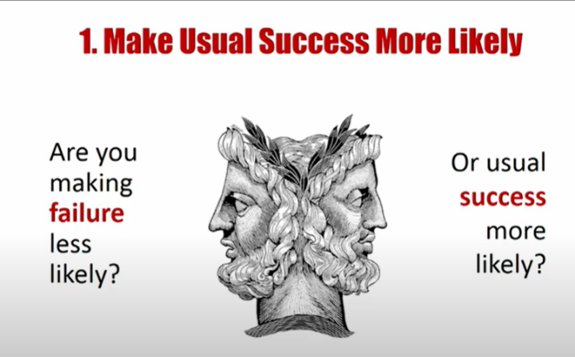

Slide 38
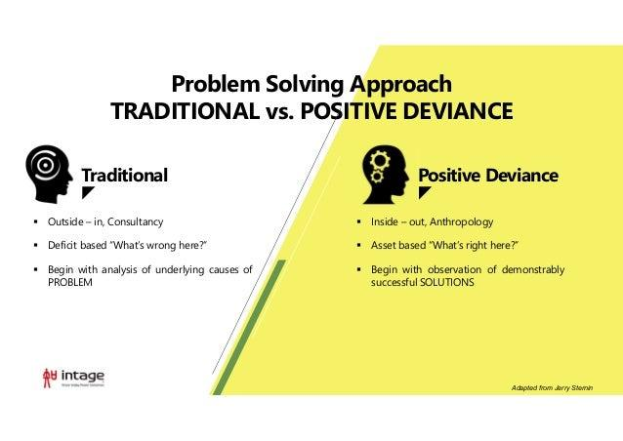
Positive deviance
Notes:
Amy- PD

Slide 39
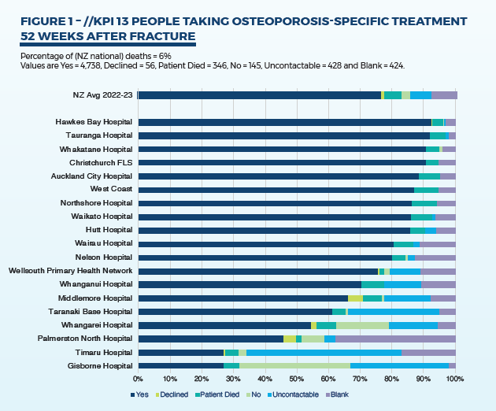
Positive deviance problem solving would focus on what is the secret sauce that means these are doing well – and how can we replicate this?
Traditional problem solving would focus on what are these hospitals doing wrong

Slide 40
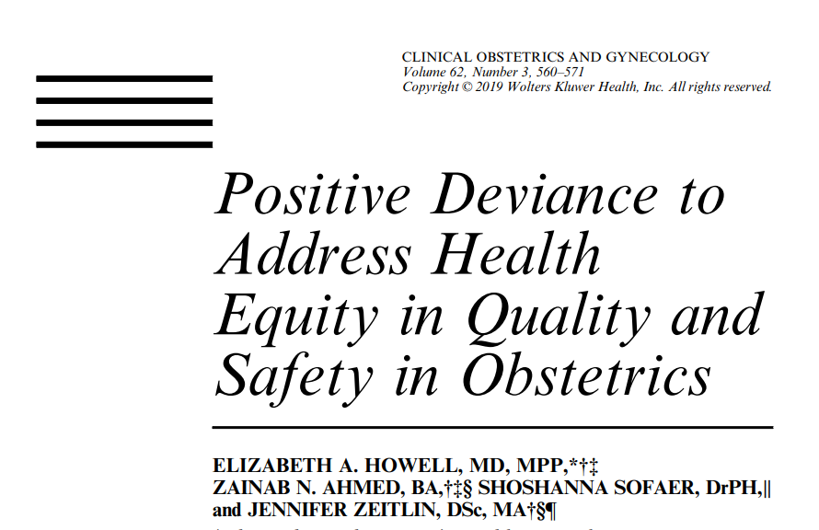

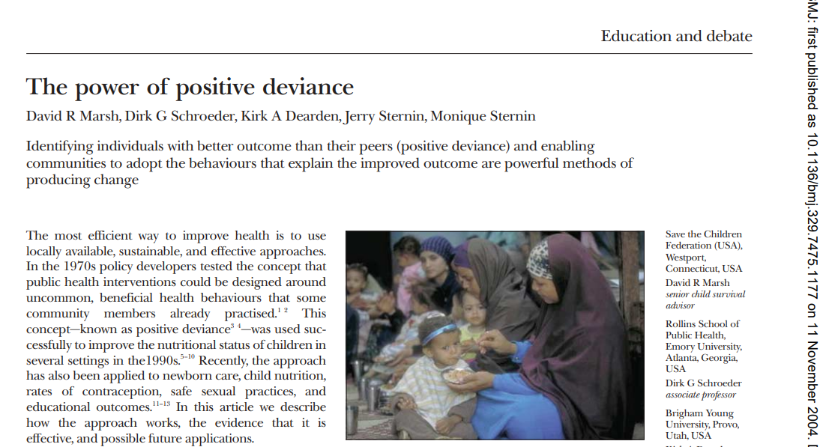
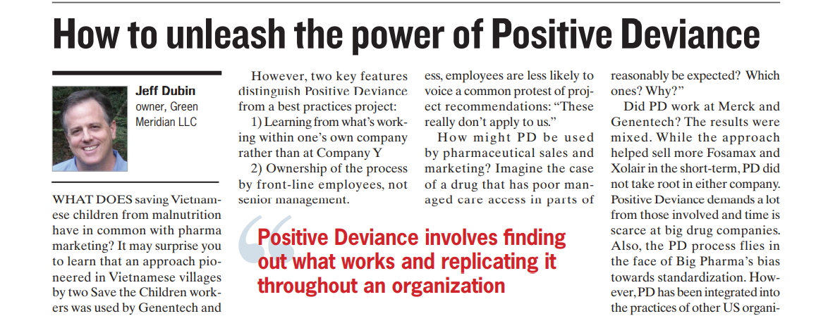
Positive deviance

Slide 41
Frameworks for
improvement

Slide 42

How do we make an improvement?
Patient presents
Take patient history
Request diagnostics
Develop a treatment plan
Monitor and adjust
Follow up
Identify opportunity
Get historic baseline
Understand current situation and root causes
Identify (potential) solutions
Test (PDSA)
Implement and sustain
This Photo by Unknown Author is licensed under CC BY-SA

Slide 43
Model for Improvement – a framework for change
3 Questions:
What are we trying to accomplish?
How will we know a change has resulted in an improvement?
What ideas do we have that will result in an improvement?
Plus
PDSA cycle

Slide 44
Model for Improvement – questions 1 and 2
What are we trying to accomplish?
How will we know a change has resulted in an improvement?

Slide 45
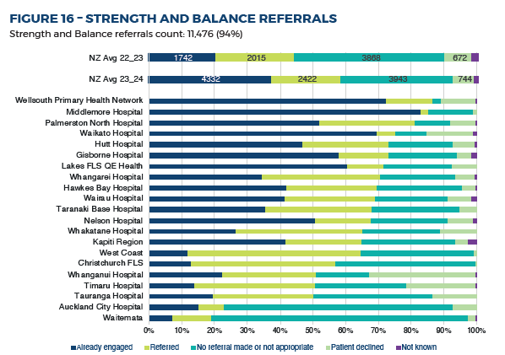
Model for Improvement – question 3
What ideas do we have that will result in an improvement?

Slide 46
PDSA learning cycle
Langley et. Al

Slide 47
PDSA hints and tips
Think small

Slide 48

Think Small
How can we achieve this?
A
P
SOMETHING
BIG!
S
D
A
P
S
D
A
P
S
D
A
P
S
D
A
P
S
D
A
P
S
D
Continuous Improvement
Small Steps
A
P
S
D
A
P
S
D
A
P
S
D
A
P
S
D
A
P
S
D

Slide 49
PDSA hints and tips
Think small
Prepare to fail….

Slide 50
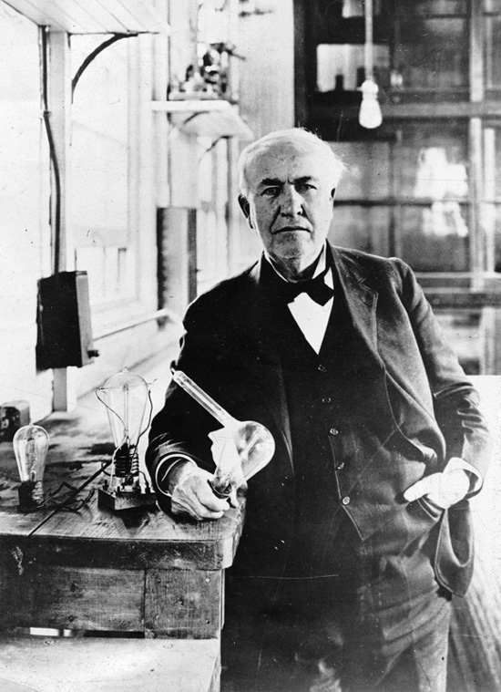
Prepare to fail…
“I did not fail one thousand times; I found one thousand ways how not to make a lightbulb”
Thomas Edison

Slide 51
Prepare to fail…
Not every PDSA will be successful
“If the plan doesn’t work, change the plan but never the goal .”
Anon.
“If plan A didn’t work the alphabet has 25 more letters“
Anon.

Slide 52
PDSA hints and tips
Think small
Prepare to fail….
Use data

Slide 53
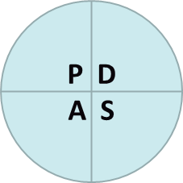
Use data
Large test – Quantitative data
Small/Medium test – Qualitative and quantitative data
Very Small test – Qualitative data

Slide 54
PDSA hints and tips
Think small
Prepare to fail….
Use data
Think a couple of cycles ahead

Slide 55

Think a couple of cycles ahead

Slide 56
PDSA hints and tips
Think small
Prepare to fail….
Use data
Think a couple of cycles ahead

Slide 57
PDSA learning cycle
Langley et. Al

Slide 58
But I do not have enough time to work this way……
“We’ve the time to do the wrong thing repeatedly but not
the right thing once”
Via Twitter @JeremyTaylorNV

Slide 59
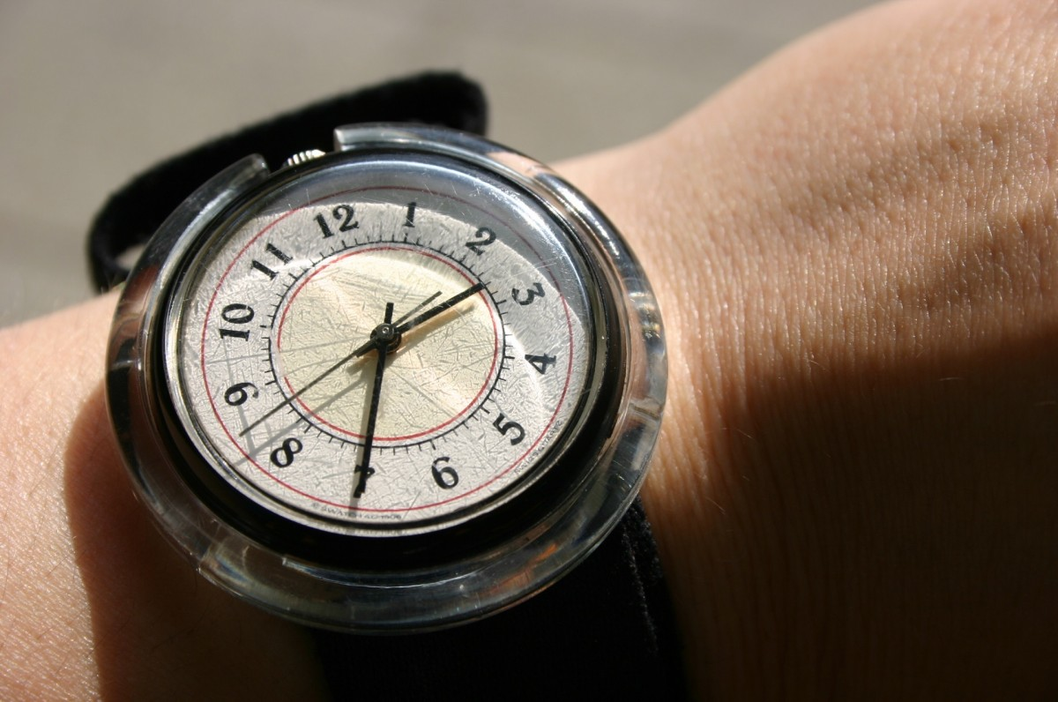
But we have tried that before……
Time is a confounding variable….
The context today is different from the context yesterday and is different from the context tomorrow – just because something succeeded or failed in the past does not mean you will get the same result today

Slide 60
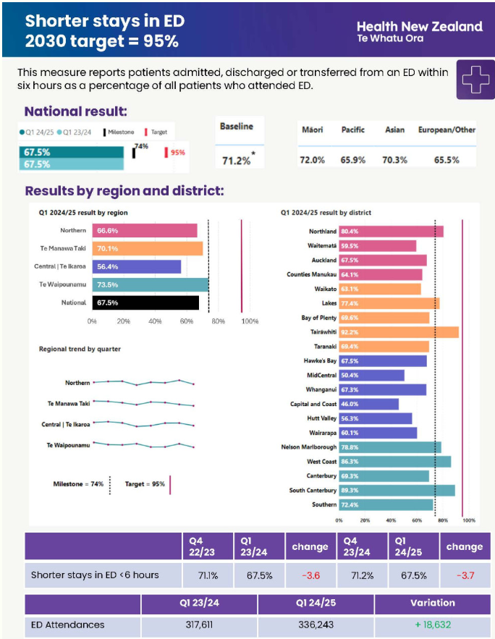
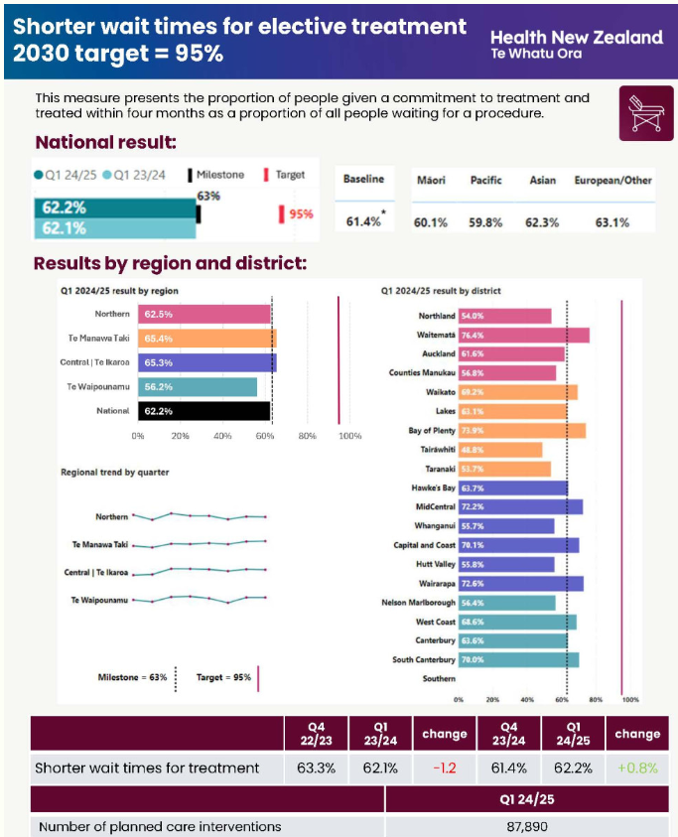
Systems thinking – how can FLS support the health targets?
Reduced refracture rate
=
Fewer presentations to ED
Reduced refracture rate
=
Fewer acute operations
=
More capacity for electives

