Slide 1
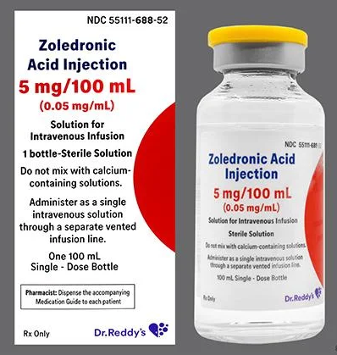
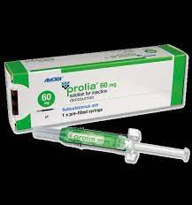
Managing treatment protocols – zoledronate & denosumab
David Kim
Waitemata

Slide 2
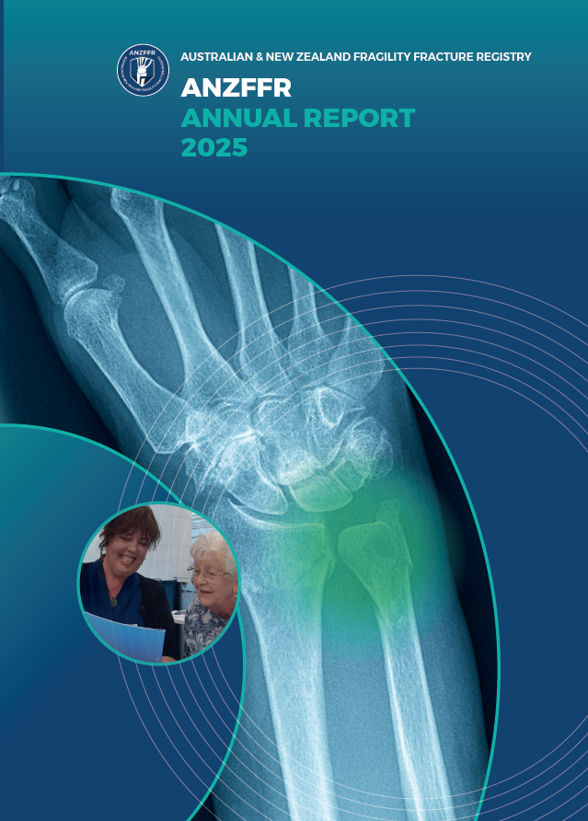
Context
Initiating pharmacotherapy in appropriate cases and ensuring treatment continuation is one of the core functions of FLS, and probably the most effective mechanism to reduce fractures in high risk patients
ANZFFR 2025 (1 July 2023 – 30 June 2024) data:
Headline outcome : “62% of those likely to benefit had a new recommendation to start treatment. 13 % were already on treatment at the time of index fracture, so 75% total treatment recommendation rate”

Slide 3
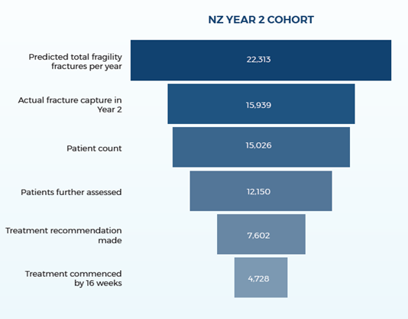
How are we really doing?
** at 12 weeks, 44% (6729/15251) of assessed FLS patients were recommended to have osteoporosis-specific treatment [13% were already on treatment]
** at 16 weeks, 51% (4314/8354) of patients started/continued on osteoporosis specific treatment of those who were recommended to do so
** at 52 weeks, 59% (4621/7807) of patients were still taking osteoporosis specific treatment of those who were recommended to do so
ANZFFR 2025 Annual Report

Slide 4
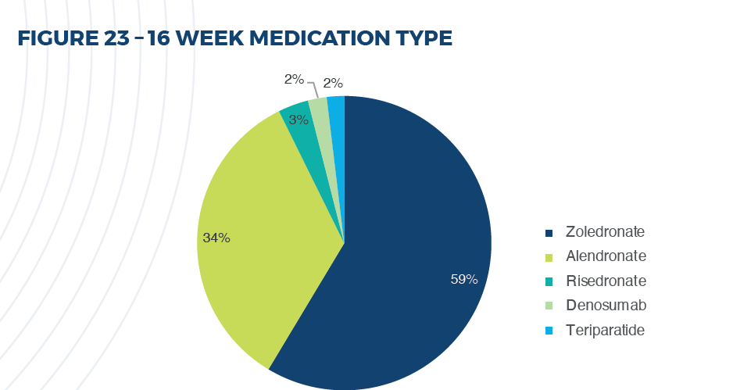
Which ‘osteoporosis-specific treatment’ did we use?
Percentage of bisphosphonate = 96% (6 : 4 ratio in favour of zoledronate), denosumab = 2%, teriparatide = 2%
ANZFFR 2025 Annual Report

Slide 5
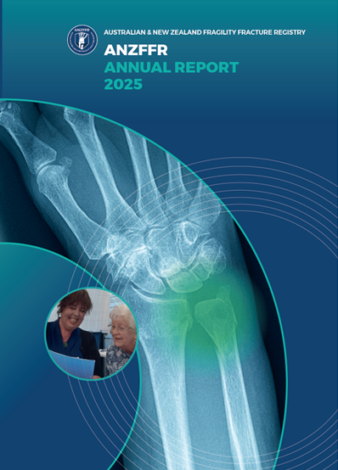
Our 2023/2024 data in summary:
Good patient identification rate
A decent proportion of identified patients advised to start osteoporosis-specific treatment
Moderate degree of under-treatment at 16 & 52-week follow ups, ‘attrition’ most likely due to treatment inertia and discontinuation of oral bisphosphonates

Slide 6

How can we do better?

Slide 7
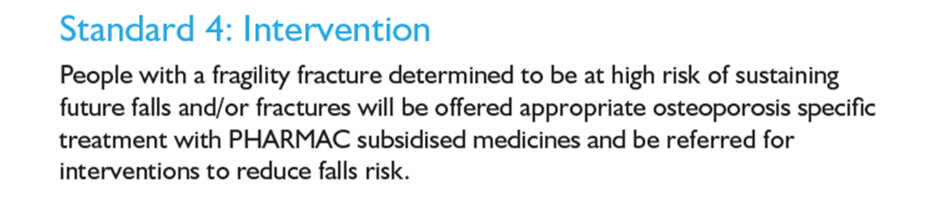
Treatment Indication (in a broader sense)
Treatment should be implemented for ‘high risk’ patients:
ONZ FLS Clinical Standards 2021
Willingness/ motivation of the patient an important factor in treatment initiation decision
Treatment futile in those with short (<1-2 years) life expectancy

Slide 8
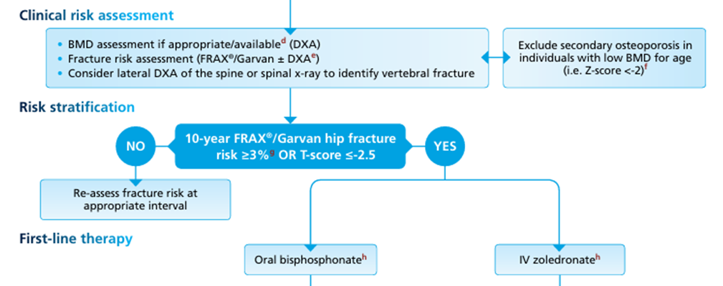
New Zealand Guideline
(ONZ Osteoporosis Management Guidance, 2017)

Slide 9
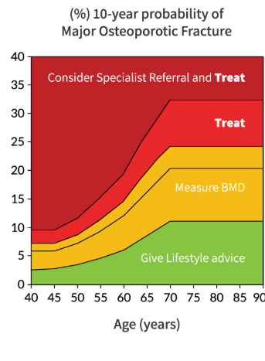
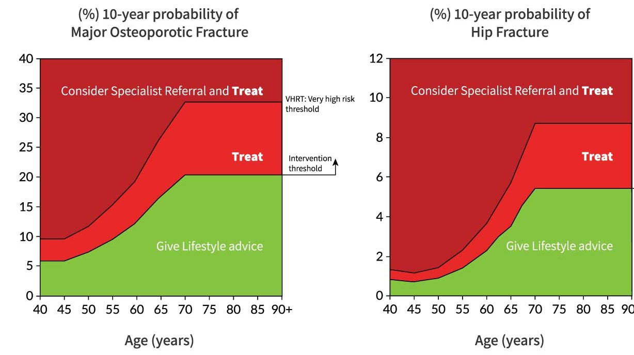
UK Guideline
National Osteoporosis Guidelines Group (NOGG) treatment algorithm (2024)

Slide 10
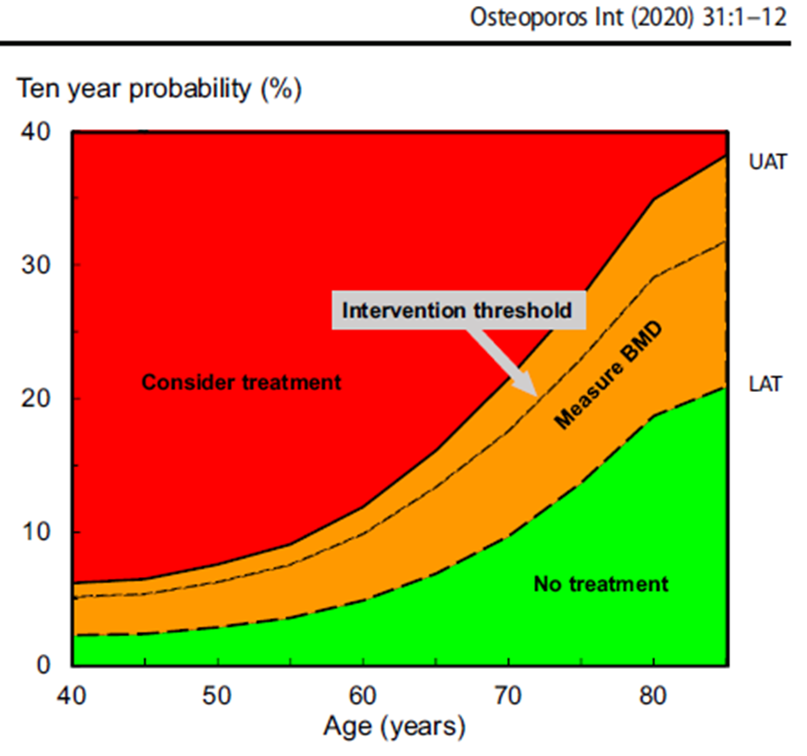
IOF-ESCEO Rx algorithm (2020)

Slide 11
History of osteoporosis specific treatment agents in NZ
Early-2000’s
Etidronate since 90s until alendronate (Fosamax) became available in early 2000’s – funded under special authority
Mid-2000s
Zoledronate became available – initially Zometa 4mg (2004) then Aclasta 5mg (2007), funded for osteoporosis under special authority since 2010
2011
Teriparatide funded under (strict) special authority
2013
Risedronate became available, no special authority restrictions
2018
Denosumab funded under (very strict) special authority
2019
2022
Zoledronate special authority removed
Mar 2025
Denosumab funding widened
Alendronate special authority removed

Slide 12
Significance of improved access to zoledronate and denosumab
1. Efficacy
[no good head-to-head RCT data but] compared to oral bisphosphonates, both zoledronate and denosumab believed to be somewhat superior in fracture prevention

Slide 13
Significance of improved access to zoledronate and denosumab
2. Compliance:
1-year compliance rate of zoledronate = 100%
denosumab ~90-95%
oral bisphosphonate ~50-60%
2-year compliance rate of zoledronate ~85-90%
denosumab ~85-90%
oral bisphosphonate ~40-50%

Slide 14
Significance of improved access to zoledronate and denosumab
3. Patient preference
Studies consistently showed patient preference strongly tied to reduced frequency of dosing (incl. preference for annual IV zoledronate over weekly oral alendronate, preference for 6 monthly denosumab over weekly alendronate)
REF: Curr Rheumatol Rep. 2015 Sep;17(9):61
My experience: oral (weekly) bisphosphonate vs. IV (12-24 monthly) zoledronate ~15% : 85%

Slide 15
Limiting factors for zoledronate
Renal dysfunction (oral bisphosphonates arguably have same issue though probably safer than IV zoledronate)
Cost/ logistics of the infusion

Slide 16
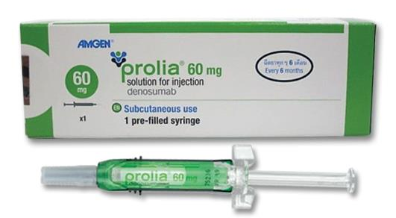
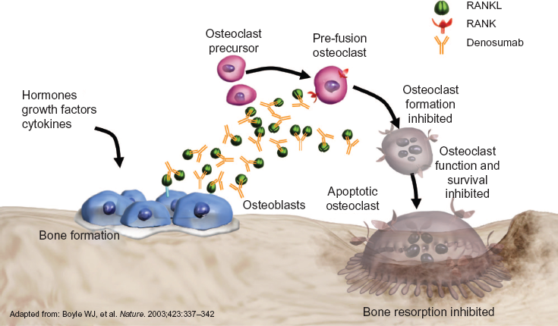
What about denosumab?
Monoclonal antibody against RANK-ligand
Powerful anti-resorptive agent
6 monthly s.c. injection
Can be used in renal dysfunction

Slide 17
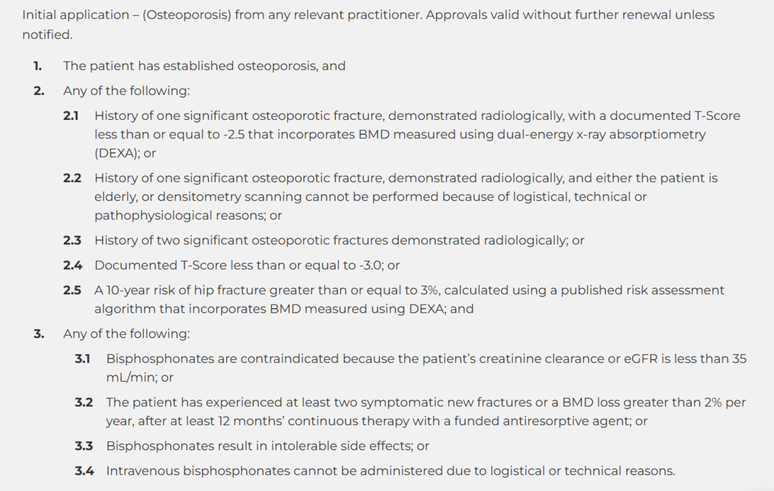


Denosumab – Who to use it in?
The majority of FLS patients
Valid reason for Dmab (not BP) use

Slide 18
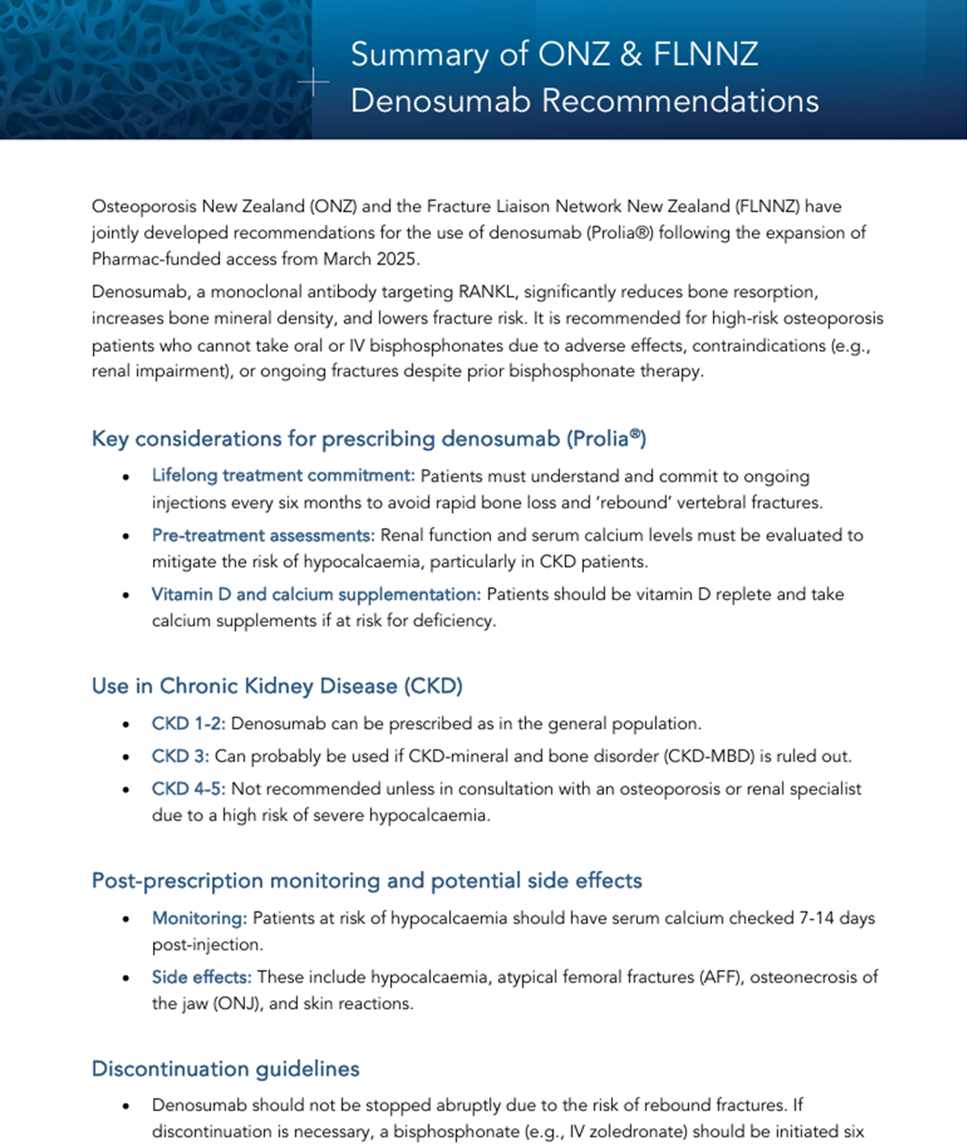
Recommendations for the use of denosumab (Prolia®) – ONZ & FLNNZ joint task force:
Frazer Anderson, Christine Gill, Harminder Gill, David Kim, Richard Macharg, Alistair
McAndrew, Natasha Nagar, Claire O’Leary, Elizabeth Spellacy, Nicola Ward https://osteoporosis.org.nz/wp-content/uploads/2025/04/ONZ-FLNNZ-Denosumab-Recommendations-final-draft-dkim-edit_sm2.pdf

Slide 19
Key messages of the denosumab document
Even if a patient fulfils the funding criteria for denosumab, think twice before starting treatment:
- essentially a life-long treatment with significant consequences if treatment (especially after 2-3 years of Rx) is delayed or ceased
- pre and post treatment precautions and screening mandatory in those at risk of hypocalcaemia (especially in CKD 4-5)
Other possible adverse effects and precautions
What to do if denosumab has to be discontinued

Slide 20
FLS patient assessment
Osteoporosis specific treatment deemed unnecessary (low fracture risk) or inappropriate (e.g. futility/ patient unwilling)
Appropriate for osteoporosis specific treatment
Non-bisphosphonate/anti-resorptive deemed more appropriate/ preferred (e.g. HRT/oestrogen based, teriparatide)
Oral or IV bisphosphonate?
No – consider/use denosumab
*contraindication (e.g. significant renal dysfunction) or intolerance to oral and IV bisphosphonates
Or
*‘Treatment failure’
AND
Appropriate for denosumab Rx (see next slides)
Yes – preferably IV zoledronate (renal function, pt. choice, logistics), otherwise oral bisphosphonate with P1NP monitoring

Slide 21
Take home messages
Initiating and ensuring continued treatment using osteoporosis specific treatment is one of the core functions of FLS and is the main mechanism by which we reduce further fractures
While our FLS patients’ treatment rate is far greater than ‘pre-FLS era’ our patients are still significantly under-treated
Latest changes to funding/ special authority of zoledronate and denosumab have/will significantly improve treatment acceptance, adherence and efficacy, and we should make most of it

